Slide 1
Name | James Small
Git Hash | 414a4c29b40e505e68a63cd4912131eb806027b3
Sprint number | Start date | end date | Work hard rating
1 | 21/03/2022 | 31/03/2022 | 4 out of 5

Slide 2
KANBAN board at the start of the sprint
NA

Slide 3
Screenshot of the game at the start of the sprint
NA

Slide 4
Sprint Reflection and summary
I believe I did a good amount of work for this sprint; I was able to establish a working base game of a spaceman moving through space around asteroids. With help from Cameron. I was able to create movement for the player sprite. It has acceleration in all directions and deceleration in all directions, the sprite is also able to rotate which also has deceleration.
I also converted the game window into a game view, because the end game will to run through arcade.views. I ran into some issues with getting the view to work, and i found i wasn't running the setup function, after i coded it in, the view opened without any problems.
I ran into some issues learning how to merge and create branches on GitHub, we also had some problems with flake8 configurations which meant every time we committed it told us there was a problem. From help of an external friend, I was able to fix the configurations and get lint and syntax working again.
I would’ve wanted to have physics engine implemented for meteor collisions, but It turned out to be difficult to do with the arcade physics engine, so I’m having to learn Pymunk to do this, so I wasn't able to implement this in sprint 1.
Overall, for the first sprint I believe we’ve done well in setting up a base game and getting the fundamentals of the game underway, so that we can build and expand the game in future sprints.

Slide 5
Briefly describe other team members contributions
Cameron has done a large chunk of this sprint in designing the player sprite asset/and player sprite asset with a gun and the first enemy sprite(enemy sprite isn't coded into game yet). He also helped me out with creating the movements for the player sprite as well. He ran into a few problems with thinking of a design idea but after researching into designs online he was able to design a good-looking sprite
Cameron also got camera centred on the player set up, meaning the player can explore the map without hitting the edges of the window. In the base game the character looks like it isn't moving due to the camera is set on him, if we adjusted the design of the background this could add the perspective of the player sprite moving.
With help from other people cam was able to draw asteroids in within a certain area, they all had different coordinates of spawn and different change in x and change in y.
Overall, Cameron has done a large part of this sprint and is a curtail part of this team, the base game would be where it is without him

Slide 6
Major Changes and Achievements Described
The sprites have been created: a player sprite (user character), a player sprite with a laser cannon, and an enemy sprite(basic enemy for game)(not coded into game yet). These are our first own assets in the game and create a foundation to build more sprites into the game.
Switched from game window into game view, this means we can have a start screen, pause menu, inventory view etc, curtail for further complexity and development into the game.
Player movement implemented into game with deceleration. W to go up, S to move down, A to go left, D to move left. LEFT arrow to rotate player left, and RIGHT arrow to rotate player right. They also decelerate character from opposite motion of movement.
set up camera to follow player sprite (makes player centre of window and moves window when player moves), means that player won't hit edges of screen unless it is meant to happen.
Asteroids will spawn in every time game is started within a set area, each asteroid sprite will have different spawn coordinates and different change in x and change in y. this adds complexity into the game and a challenge for player to move around. In further development they will be used to gather resources.

Slide 7
Brief Description of your testing
We tested whether the movement for the player sprite was working and that it looked to what we wanted it to be. We did this by moving the character around the screen and seeing whether it accelerated and decelerated properly and if it was at the right speeds. We also checked if the rotation controls and movement for the player sprite were accurate and worked properly. After testing all of this we found that it did work properly to how we wanted it to be and it even looked life like for how it would be in real reality, it past testing
We also tested the spawn and movement of the asteroids, and found it worked well even though collisions haven't been set up yet and that it would work in the larger scale of the later game.
We tested whether the camera that followed the player sprite was setup, we did this by moving the player sprite around and seeing whether it hit the edges of this screen or not. We found it did not and that the camera was working how it was meant to work.
We also checked whether the game view started up correctly and that the game started up how it was meant to. We found that it did and the transition from window to views was successful.
Overall, everything we tested passed and works in the game how it is intended to work.

Slide 8
Link to testing results/tables

Slide 9
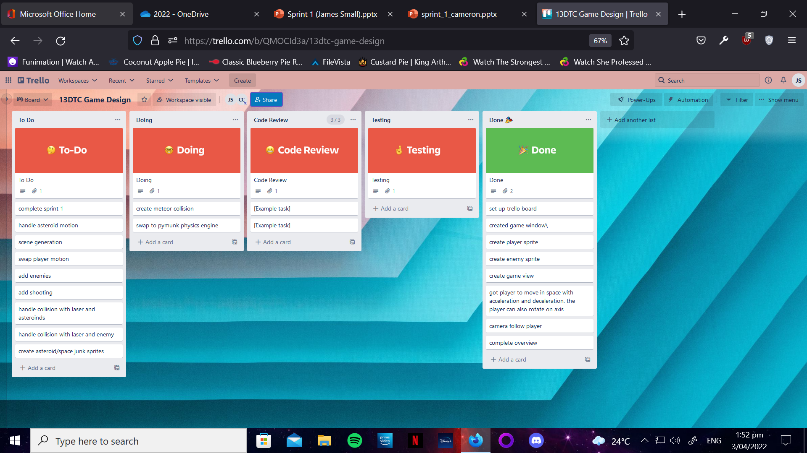
KANBAN board at the end of the sprint

Slide 10
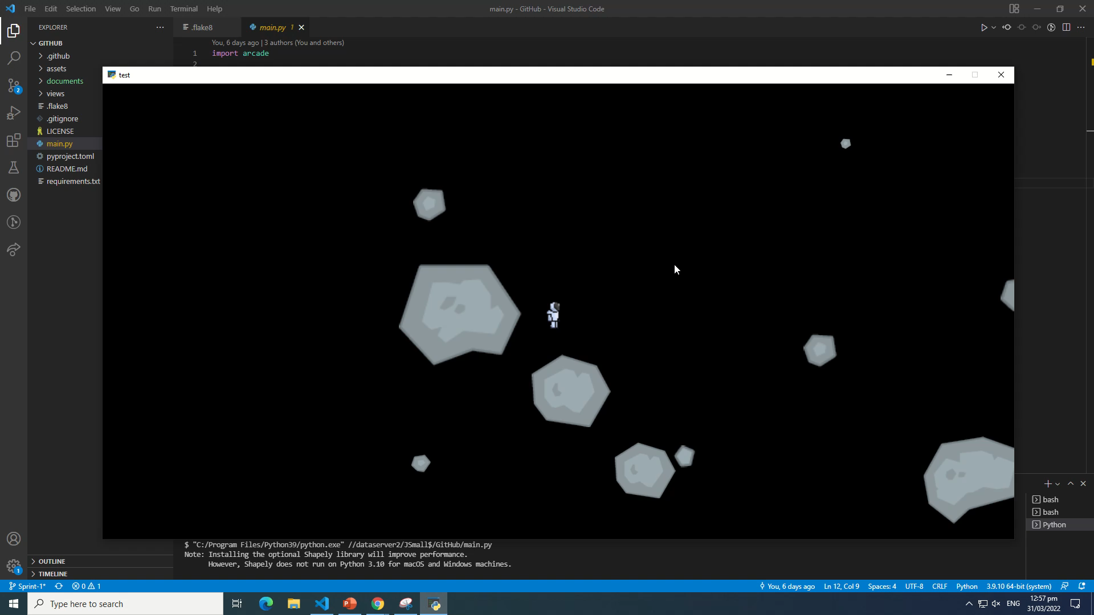
Video of the game at the end of the sprint

Slide 11
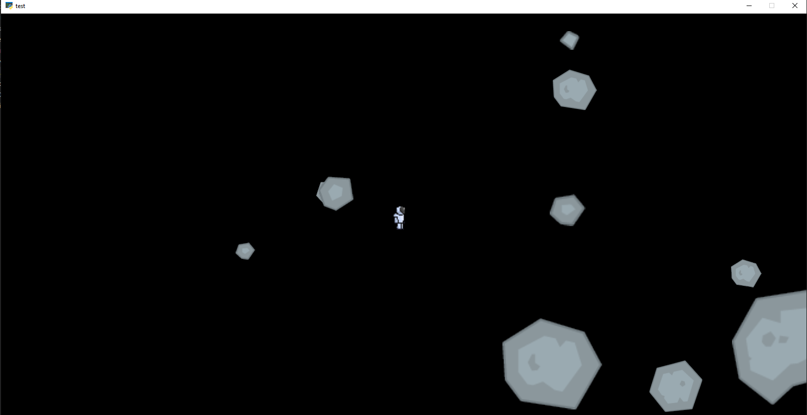
Screenshot of the game at the end of the sprint

Slide 12
Notes for next time, future improvements
For the first sprint I believe it has gone well and that there has been a lot done. For the next sprints I want to expand and refine the game further so that the complexity of the game is greater so that people who play the end game enjoy it. For future improvements on the game i want to add a pymunk physics engine in, so that i can do collisions for meteors and player and so that i can implement enemies into the game and so they can seek and destroy the player sprite. The game still has a long way to go to be a finished product.
Need to add next sprint:
Pymunk Physics engine
Collisions for meteors
Collisions for player and meteors
Add enemy into the game and code for it to function
Expand the game area and expand area for spawning meteors
Integrate more sprites into the game
Add player shooting and mining abilities
Make meteors minable for resources
Add a start view
Add pause view
Add a death

